Slide 1
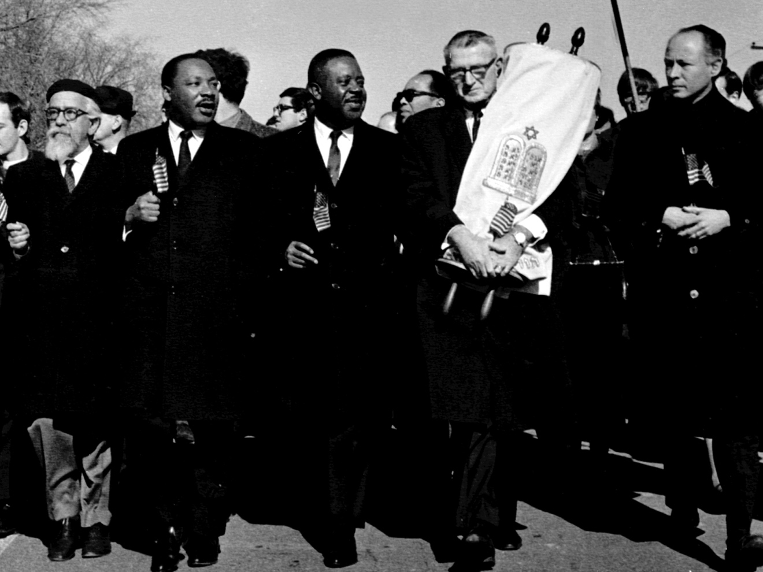
Are we afraid to talk about racism?
Town Hall #10

Slide 3
Questions to consider
Why is race still such a divisive issue almost 50 years after the passage of the Civil Rights Act?
How does American culture shape our attitudes towards race?
How does “racial indifference” contribute to our reaction to racial issues?
How does “the bubble” impact our ability to truly recognize–and understand–the grievances of another community?
How can we pop the bubble?
What does it mean to be an upstander? How does the Jewish experience of discrimination shape our outlook?

Slide 4
Statistics
African Americans are incarcerated at grossly disproportionate rates, despite the fact that crime rates (both violent and non violent) are similar among both groups
In less than 30 years, the US penal population exploded from around 300,000 to more than 2 million, with drug convictions accounting for the majority of the increase. The United States now has the highest rate of incarceration in the world, dwarfing the rates of nearly every developed country, even surpassing those of highly repressive regimes like Russia, China, and Iran.
The racial dimension of mass incarceration is its most striking feature. No other country in the world imprisons so many of its racial or ethnic minorities. The US now imprisons a larger share of its black population than South Africa did at the height of apartheid. In Washington DC, it is estimated that three out of four black men can expect to serve time in prison.
Studies show that people of all colors use and sell drugs at remarkably similar rates.

